Slide 1
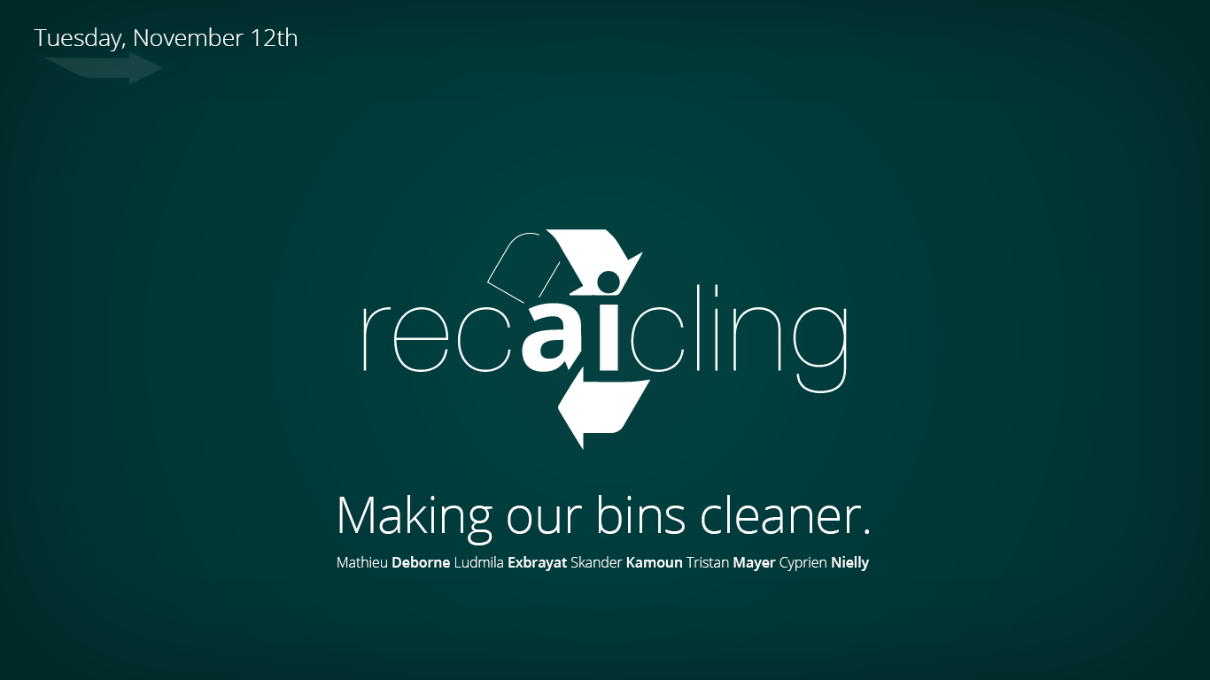

Slide 2
Agenda
I – Introduction
2 – Overview of our model
3 – Deep diving on the challenges
4 – Next steps

Slide 3
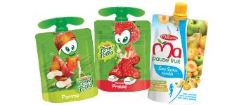
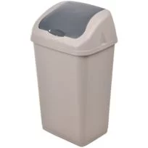
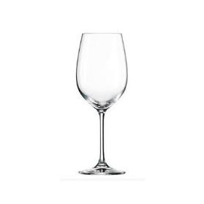
If you were in Paris, where would you put these items?

Slide 4
In France, only 43% of domestic waste is recycled
Recycling in France is challenging
This results in France being an average student in EU
The rules for recycling are not harmonized and differ from one city to another.
The rules for recycling can be complex.
The rules for recycling are changing over time.
Source: Eurostat 2017
Notes:
Autre source pour le ~45% : https://www.statistiques.developpement-durable.gouv.fr/sites/default/files/2018-10/Datalab-25-menages-environnement-cc-ed-2017-oct2017-b.pdf
Cyprien: « In France, 70 % of our garbage can be recycled or transformed
Several goods car be donnated to organization that offer a second life to your objects. Tis is the case for clothes, books, household linen, DVD, CD, toys, etc”

Slide 5
AI can help addressing this challenge
1
The user takes a picture of the item
2
Our app recognizes the materials …
3
… and recommends how to recycle it

Slide 6
Agenda
I – Introduction
2 – Overview of our model
3 – Deep diving on the challenges
4 – Next steps

Slide 7
We trained deep neural networks to recognize the materials
Schema of our network
Model’s output
Plastic
User’s input
VGG-16
Custom layers

Slide 8
Does it work?
Let’s do a live demo

Slide 9
These networks achieved an accuracy of 88%
PERFORMANCE METRICS
83%
Accuracy on
Material Recognition
92%
Accuracy on
Container Recognition
88%
Accuracy on
Overall Recognition

Slide 10
Agenda
I – Introduction
2 – Overview of our model
3 – Deep diving on the challenges
4 – Next steps

Slide 11
We have faced multiple challenges
1
2
3
4
Gathering a training set
Loading and formatting the images
Creating a custom loss function
Adding custom layers

Slide 12
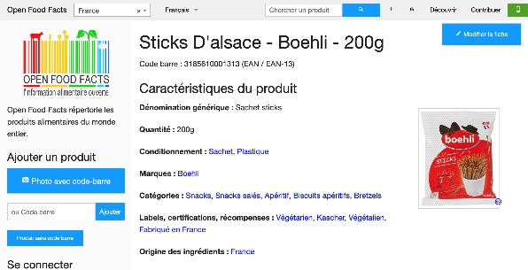
Gathering a training set (1/2)
1
Finding a dataset
USING OPEN FOOD FACTS API
d
Example
Characteristics
Limitations
This dataset is in open source.
It is regularly updated.
It contains more than 1 million items.
It only contains food packages.

Slide 13
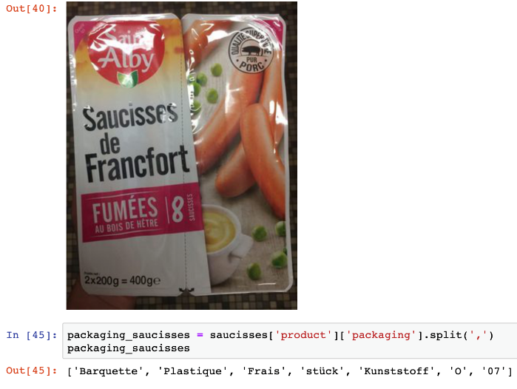
Gathering a training set (2/2)
1
Cleaning the dataset
WHY WE HAD TO PERFORM A CLEANING PHASE
d
Problem
Solution
Selecting only a subset of categories
Share of images in each category

Slide 14
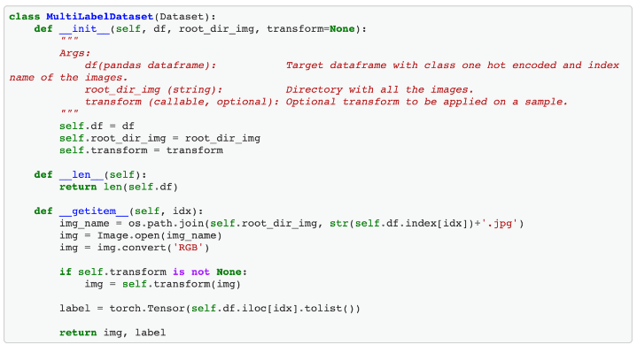
Loading and formatting the images (1/2)
2
Building a custom Data Loader
WHY WE HAD TO BUILD A CUSTOM DATA LOADER
d
Problem
Solution
In our problem, an image can have multiple labels.
→ we could not organize our images as usual (with two folders, train and test, and subfolders in train).
Build a custom class, called MultiLabelDataset

Slide 15
Loading and formatting the images (2/2)
2
Formatting the images
WE FACED MULTIPLE TRADE-OFFS
d
Questions
Our choices
Should we …
Crop and center
No
because the images were already cropped and centered
Normalize
No
Resize
Yes
because the images had distinct sizes
?

Slide 16
Creating a custom loss function (1/4)
3
Why would we even need a custom loss?
1ST REASON: INSTILL EXPERT KNOWLEDGE WITHIN THE NETWORK
Example
Network with General Loss
Network with Custom Loss
Example
Standard loss only comparing if predicted labels MATCH true labels
Custom loss comparing HOW FAR the predicted labels are from the true labels based on expert knowledge
True Labels
Plastic - Bottle
Predicted Labels
Associated Loss
Associated Loss
1st Iteration: Metal - Box
1.0
1.0
2nd Iteration: Glass
1.0
0.7
3rd Iteration: Glass – Jar
1.0
0.5
The network does not notice any improvement
The network sees the
improvement

Slide 17
Creating a custom loss function (2/4)
3
Why would we even need a custom loss?
2ND REASON: COUNTER CLASS IMBALANCE
Example
Network with General Loss
Network with Custom Loss
1st Example
IMABALANCED DATA WHERE PLASTIC IS OVERWHELMING OTHER LABELS
True Labels
Plastic - Bottle
Predicted Labels
Plastic
Predicted Labels
Plastic – Bottle
Network is incentivized to only discriminate plastic from non plastic or even to predict impute with plastic everywhere
Network is incentivized to discriminate all labels properly
2nd Example
True Labels
Cardboard – Box
Predicted Labels
None
Predicted Labels
Cardboard – Box
Learning biased by
class imbalance
Learning unbiased thanks to differentiated loss

Slide 18
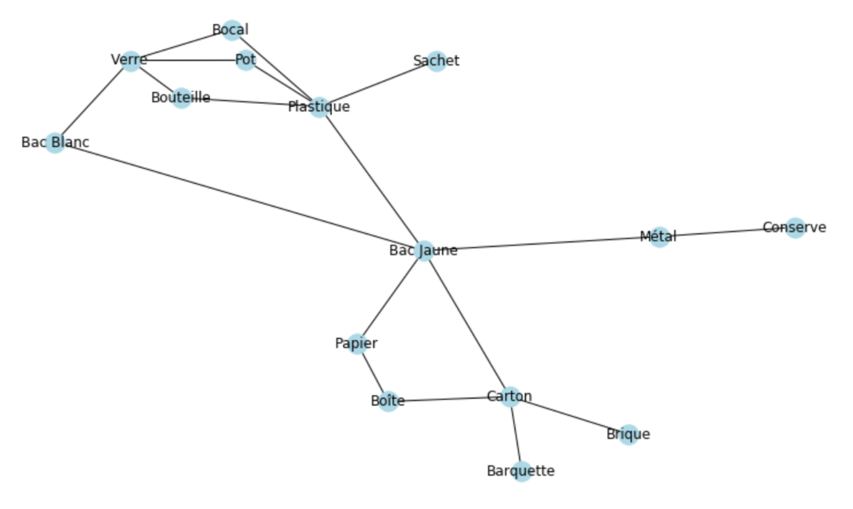
Creating a custom loss function (3/4)
3
How did we build our custom loss?
CREATE AN ACYCLIC WEIGHTED GRAPH TO REPRESENT THE RELATIONSHIPS BETWEEN THE LABELS
÷2
INTERBIN DISTANCE
MATERIAL-TO-BIN DISTANCE
÷2
CONTAINER-TO-MATERIAL
DISTANCE
NEXT STEP
Derive of a Loss from the
Differentiated Distances

Slide 19

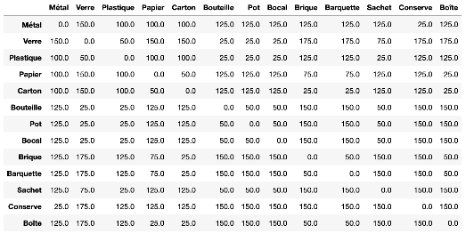
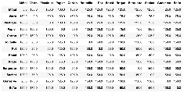
Creating a custom loss function (4/4)
3
How did we implement our custom loss?
MATRIX MULTIPLICATION BASED ON THE OUTPUT FROM THE UNDERLYING ACYCLIC GRAPH
Acyclic Weighted Graph
Shortest Path Distance Matrix
DIJSKTRA ALGORITHLM
Standard BCE Loss Vector
Short Path Distance Matrix
0.43
…
0.58
0.32
…
Custom Loss Vector
0.65
Custom Loss Average(Custom Loss Vector)
0.43

Slide 20
Adding custom layers
4
Schema of our network
User’s input
VGG-16
Custom layers
Model’s output

Slide 21
Agenda
I – Introduction
2 – Overview of our model
3 – Deep diving on the challenges
4 – Next steps

Slide 22
This model is just a first step
1
2
3
4
Improve our model
Integrate this new feature into our app
Release our app
Monetize the app
Using a larger and more diverse (e.g. not only food packages) training set.
Testing new combinations of custom layers and / or using another trained network (e.g. ResNet18).
Leveraging the information “Bouteille”, “Barquette”.
Implementing OCR.
Build a new section in the app where the user can take a picture of the item, in addition to the one where it can scan the bar code.
Optimize the algorithm so the predictions are immediate.
Design a minimum viable test to identify the features perfectly in line with users’ needs.
Iterate the feedback – update process until we get a 5-star product.
Devise a growth strategy for launching the app.
Multiple options:
Create a subscription plan for the final users.
Create a subscription plan for the cities / regions.
Sell advices to firms to advise them on how to get better scores on our app.
Exit by selling to Yuka.

